Slide 1
Overview of Oracle Backup and Recovery
Darl Kuhn, Regis University

Slide 2
Backup and Recovery Planning
How valuable is your data?
How much data can you lose?
Is the data easily recreated?
Mean time to recovery requirements (MTTR)
Availability requirements
Disaster recovery requirements (DR)
Test Plan
How much money can you spend?

Slide 3
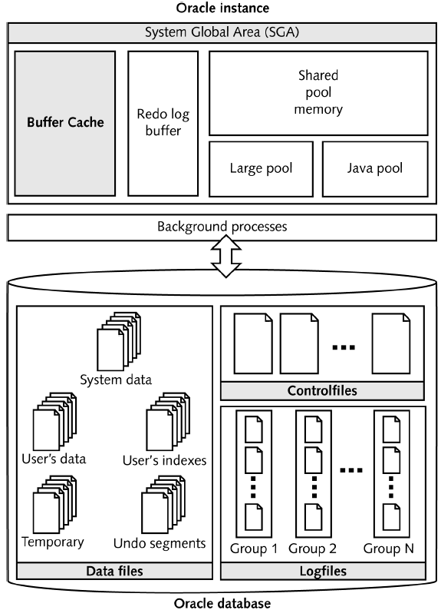
Oracle Architecture

Slide 4
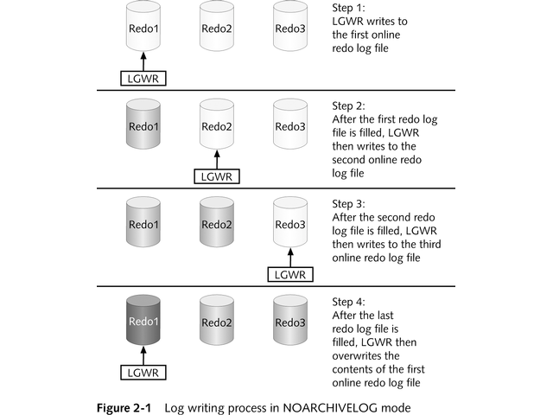
Noarchivelog Mode

Slide 5
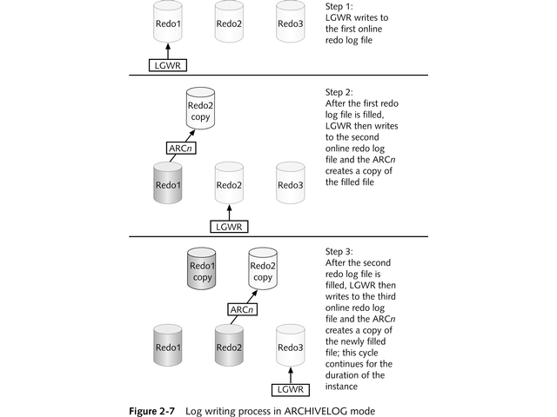
Archivelog Mode

Slide 6
Archivelog Mode Continued
Advantages
  Enables mechanim for recovery of every comitted transaction
  Enables online backups (Hot or RMAN)
Disadvantages
  Requires additional storage
  Additional administrative overhead
  Additional process (ARCn) and I/O

Slide 7
Enabling Archivelog Mode
SQL> shutdown immediate;
SQL> startup mount;
SQL> alter database archivelog;
SQL> alter database open;
In your init.ora or spfile:
log_archive_start=true
Note: log_archive_start is deprecated in 10g

Slide 8
Types of Backups
User Managed Physical Backups
  Cold (offline)
  Hot (online)
User Managed Logical Backups
  Export
  Data Pump (10g only)
Recovery Manager (RMAN)
  Offline physical
  Online physical
3rd Party Tools

Slide 9
Cold Backup (offline)
Database shutdown during backup
Uses operating system copy command
Cold Backup Steps:
1. Determine location of datafiles, controlfiles, and online redo logs
2. Shutdown immediate, transactional, or normal
3. Copy files to backup location
4. Startup database

Slide 10
Hot Backup (online)
Database must be in archivelog mode
Tablespaces must be altered in and out of backup mode
Database remains online during backup
While tablespace in backup mode:
  When a block first changes
  Full block written to redo stream
  Not just the atomic change vector
  Can be significant performance hit
Very common misperception that DBWn stops writing to datafiles during Hot Backup, not true!

Slide 11
Hot Backup Procedure
Hot Backup has more moving parts than a Cold:
1. Ensure database in archivelog mode
2. Determine which files to backup
3. Switch on-line redo logs
4. Alter tablespaces into backup mode (serial or parallel)
5. Use an OS utility to copy datafiles to backup location
6. Alter tablespaces out of backup mode
7. Switch on-line redo logs
8. Copy any archive redo logs generated during backup
9. Backup the controlfile via "alter database backup controlfile to <location/name>";

Slide 12
Logical Backups
Export
Data Pump export:
  10g only
  Performance
  Schedule data pump jobs within the server
  Control and monitor data pump jobs from a different session
  Enhanced ETL operations

Slide 13
Recovery Manager (RMAN)
RMAN is a tool that can be used for backup, restore, and recovery of Oracle databases
First shipped with Oracle version 8.0
Oracle's recommended tool for B&R
No extra license required

Slide 14




RMAN Architecture
Server
Processes
Target
Database
datafiles
Target
Database
Datafiles
rman
Server
Processes
Server
Processes
Recovery
Catalog
Database
(optional)
controlfiles
Archived
redo logs
Backup files
on disk
Media
Management
(optional)
Backup
media

Slide 15
RMAN Advantages
Tablespaces not put in backup mode
Incremental backups
Block corruption detection
Configurable I/O features
Logging of backup operations
Integrates with Media Management Layer (MML) software

Slide 16
RMAN 9i New Features
Backup optimization
Restore optimization
Block level recovery
New features for archive redo log backups
Configurable persistent settings, automatic backup of controlfile, spfile
Simplied syntax
Retention policy

Slide 17
RMAN 10g New Features
Flash recovery
Change tracking
Incremental merge
Backup duration
Compressed backups
Automatic channel failover
Restore failover
Restore preview
Automatic creation of missing datafiles
Recovery through resetlogs

Slide 18
RMAN Backups
Should you use a recovery catalog?
Should you use a MML?
Online or Offline
Database must be in archivelog mode for online RMAN backups
Can be as simple as:
RMAN> backup database;

Slide 19
Failures Happen
Non-Media Failure
  Process failure
  Statement failure
  User error
  Instance failure
Media Failure
  Oracle unable to perform I/O on database file
  Requires DBA intervention

Slide 20
Crash vs. Media Recovery
On startup, Oracle determines whether crash or media failure situation exists:
IF (cf SCN = df SCN) THEN
Startup normally;
ELSE IF (cf stop SCN = infinity) THEN
SMON performs crash recovery;
ELSE IF (cf SCN > df SCN) THEN
Throw media failure error;
ELSE IF (cf SCN < df SCN) THEN
Throw controlfile too old error;
END IF;

Slide 21
Restore and Recovery
Restore is copying datafiles back from the backup set
Recovery is apply redo to the datafiles via a “recover” command
Many, many different B&R scenarios
Restore and recovery procedure varies widely depending on:
  Type of backup
  Type of failure (datafile, controlfile, redo)
  Archivelog or noarchivelog mode

Slide 22
Noarchvielog Mode Restore
Restore from Cold Backup or an RMAN offline backup
Restores to the point in time the backup was taken
No redo available to restore transactions
Most likely will result in loss of data

Slide 23
Archivelog Mode Restore and Recovery
Restore datafiles from:
  Cold backup
  Hot backup
  RMAN online or offline backup
Issure “recover” command to apply redo
SQL> recover database ....
Recovery can be either complete or incomplete

Slide 24
Complete Recovery
Complete recovery means that you can recover all transactions ever comitted in the database
You're restoring the database to the point in time right before the failiure occurred
Complete recovery only available for archivelog mode databases
Complete does not mean that you have to restore and recover all datafiles
Only have to restore and recover datafiles that have experienced media failure

Slide 25
Incomplete Recovery
All transactions are not restored
Three types of incomplete recovery:
  Change (SCN)
  Time
  Log
Basic procedure:
  Copy all datafiles back from the backup set
  Rollforward to desired point
  SQL> alter database open resetlogs;

Slide 26
Summary
Develop B&R plan that meets business requirements
Wide variety of methods to backup and recover your database
Use RMAN
“Your backup is only as good as the last time you tested it...”

